Slide 1


Metal artifact reduction in CT and MRI using Unsupervised machine Learning algorithms
PANIMALAR ENGINEERING COLLEGE
Department of Computer Science and Engineering
PROJECT GUIDE :
A. N. Sasi Kumar Assistant Professor GRADE-1
TEAM MEMBERS :
1) Yeshwanth . S (211417104311)
2) Tinu pratheep dharshan . S (211417104283)
3) Vinodh kumar .S (211417104303)

Slide 2
OUTLINE
ABSTRACT
SYSTEM ARCHITECTURE
PROPOSED SYSTEM
ALGORITHIM IMPLEMENTATION
SCREENSHOTS OF WORK
LITERATURE SURVEY
HARDWARE AND SOFTWARE
CONCLUSION
REFERENCES
1

Slide 3
ABSTRACT
Nowadays, three-dimensional (3D) imaging is one of the successful clinical applications , . In spite of improvements in imaging methods, researchers are faced with various problems. One of the problems is that high-density objects exist in CBCT images such as metal implants and dental fillings and create a lot of artifacts.
These artifacts considerably reduce the graphical quality of the image and alter the skeletal structure close to metallic substances.
Considering independency of this algorithm from data acquisition part, it can be used along with other artifact reduction algorithms which modify scanning algorithm to reduce artifacts.
2

Slide 4
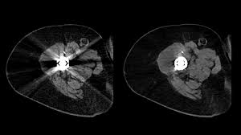
Methods to overcome metal artifacts in Computed Tomography (CT) images have been researched and developed for nearly 40 years.
Metal objects such as a dental filling, artificial hip, spine implant, or surgical clip in the field of view will strongly attenuate x-rays or even completely block their penetration, resulting in corrupt or missing projection data received by the detector known as artifacts.
It may result in the improper Diagnosing of the report of the concerned patient.We will discuss some advanced methods to correct artifacts.
THE ABOVE PICTURE SHOWS THE METAL REFLECTING THE RAYS
3

Slide 5
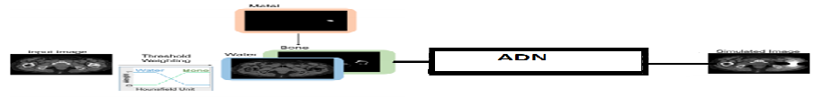
SYSTEM ARCHITECTURE
Intial stage usable data is recovered from the NMAR files
Then we are training the data using deep learning algorithm (i.e.. CNN)
And then we are using a unsupervised machine learning algorithm that is AND for reducing the artifact
The above picture shows the architecture of the algorithim
4

Slide 6
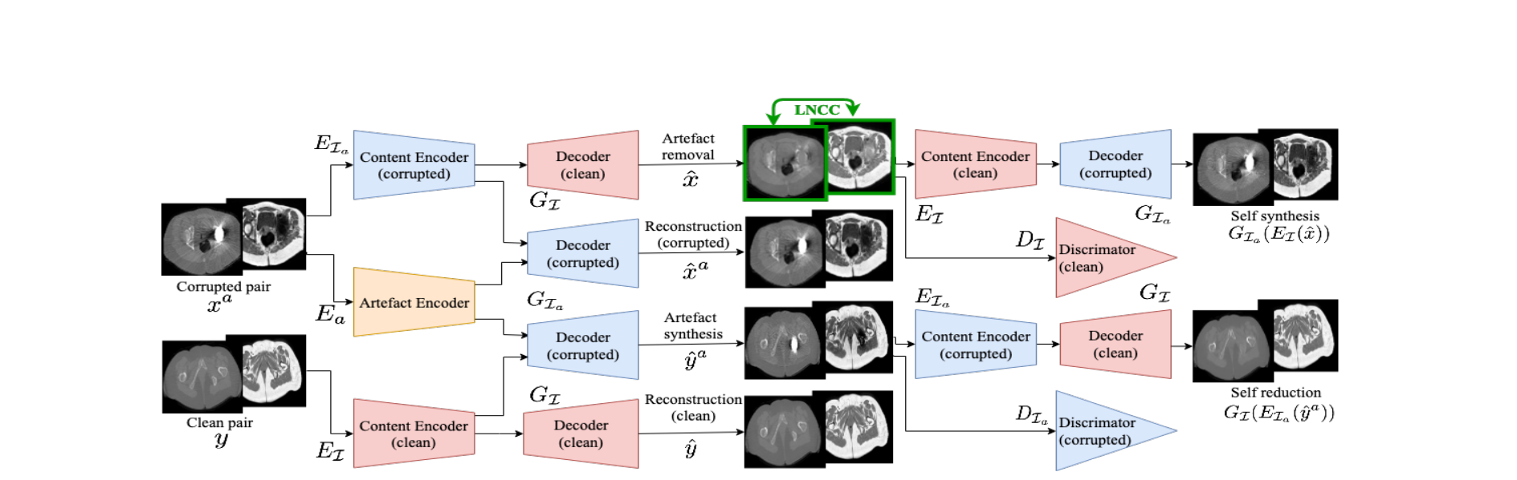
SYSTEM ARCHITECTURE
Block diagram of the architecture
5

Slide 7
PROPOSED SYSTEM
The proposed algorithm corrects reconstructed CT images.
The projected data which is affected by metal fillings is detected and the missing projections are replaced with data obtained from a corresponding MR image.
A simulation study was conducted in order to compare the reconstructed images with images reconstructed through linear interpolation, which is a common metal-artifact reduction technique along with the different thresholding techniques and correction algorithms accordingly.
The results show that the proposed method is successful in reducing severe metal artifacts without introducing significant amount of secondary artifacts.

Slide 8
ALGORITHM-CNN
A Convolutional Neural Network (ConvNet/CNN) is a Deep Learning algorithm which can take in an input image, assign importance (learnable weights and biases) to various aspects/objects in the image and be able to differentiate one from the other.
The pre-processing required in a ConvNet is much lower as compared to other classification algorithms. While in primitive methods filters are hand-engineered, with enough training, ConvNets have the ability to learn these filters/characteristics.
A ConvNet is able to successfully capture the Spatial and Temporal dependencies in an image through the application of relevant filters.
7

Slide 9
ALGORITHM-ADN
Current deep neural network based approaches to computed tomography (CT) metal artifact reduction (MAR) are supervised methods that rely on synthesized metal artifacts for training.
However, as synthesized data may not accurately simulate the underlying physical mechanisms of CT imaging, the supervised methods often generalize poorly to clinical applications. To address this problem, we propose, to the best of our knowledge, the first unsupervised learning approach to MAR.
Specifically, we introduce a novel artifact disentanglement network that disentangles the metal artifacts from CT images in the latent space. It supports different forms of generations (artifact reduction, artifact transfer, and self-reconstruction, etc.) with specialized loss functions to obviate the need for supervision with synthesized data.
8

Slide 10
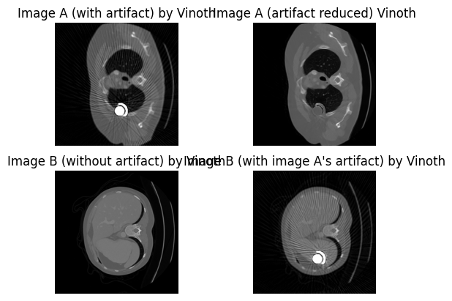
SCREENSHOT
The above image shows the final result that is a image with reduced artifact and a image without artifact
9

Slide 11
LITERATURE SURVEY
S.NO | JOURNAL DETAILS | TECHNIQUES USED | INFERENCE
1. | Ghani, Muhammad Usman and Karl, W Clem, “Fast Accurate CT Metal Artifact Reduction using Data Domain Deep Learning,” IEEE Transactions on Computational Imaging, 2019. | Deep Learning | The standard practical approaches to reducing metal artifacts in CT imagery are either simplistic non-adaptive interpolation-based projection data completion methods or direct image post-processing methods.
2. | Kim, Jiwon and Kwon Lee, Jung and Mu Lee, Kyoung, “Accurate image super-resolution using very deep convolutional networks,” in Proceedings of the IEEE Conference on Computer Vision and Pattern Recognition, 2016, pp. 1646–1654 | Deep Convolutional Networks | We find increasing our network depth shows a significant improvement in accuracy
10

Slide 12
3 | Xia Huang, Jian Wang, Fan Tang, Tao Zhang & Yu Zhang. Metal artifact reduction on cervical CT image by deep residual learning, 2018 | RL-ARCNN | Metal artifacts are eliminated efficiently free of sinogram data and complicated Post-processing procedure.
4 | Brian A. Hargreaves¹, Pauline W. Worters¹, Kim Butts Pauly¹, John M. Pauly², Kevin M. Koch³ and Garry E. Gold, Metal-Induced Artifacts in MRI,2011 | Steps involved with patients motion and using different types of other metals | We find increasing our network depth shows a significant improvement in accuracy
JOURNAL DETAILS
TECHNIQUES USED
S.NO
INFERENCE
11

Slide 13
S.NO | JOURNAL DETAILS | TECHNIQUES USED | INFERENCE
5. | Yakdiel rodriguez-gallo, ruben orozcomarlen perez-diaz Metal artifact reduction by morphological image filtering for computed tomography,(2019) | Morphological Image Filtering Approach for Metal Artifact Reduction (MIFMAR) algorithm. | Linear Interpolation technique is used so this method cannot be fully satisfied for all types of CT or in other words the morphed image cannot be fully effective in certain scenario.
6. | Department of Radiology, Yonsei University College of Medicine, Yonsei-ro, Seodaemun-gu, Korea Northwestern University Feinberg School of Medicine, UNITED STATES Metal implants influence CT scan parameters leading to increased local radiation exposure.(2019) | A proposal for correction techniques. | organ dose modulation (ODM) metal artifact reduction (MAR) protocols on dose reduction Gemstone spectral imaging, (GE)
7. | YAN XI, YANNAN JIN High-kVp Assisted Metal Artifact Reduction for X-Ray Computed Tomography(2016) | Iterative methods handle photon starvation by discarding or underweighting corrupted data. | Computed tomography, metal artifact reduction, kVp switching, iterative reconstruction.
12

Slide 14
HARDWARE AND SOFTWARE REQUIREMENTS WITH SPECIFICATIONS(MINIMUM)
Operating System : Windows 8(64bit)
Processor : Intel i3(3.6GHz)
RAM : 4GB
GPU : NVIDIA GeForce or AMD Radeon
System Space : 10GB
Software : Sublime text(python)
13

Slide 15
CONCLUSION
With the help of Datasets of scans we are able to make the machine understand the situation and reduce the effect of Metal Artifact by using customised ADN(Artifact Disentanglement Network) Algorithm .
Henceforth, the machine can produce the results from the datasets samples stored using Realtime Machine Learning process.
14

Slide 16
REFERENCES
Andras Anderla, Dubravko Culibrk, Gaspar Delso, Milan Mirkovic, "MR Image Based Approach for Metal Artifact Reduction in X-Ray CT", The Scientific World Journal, vol. 2013, Article ID 524243, 8 pages, 2013.
A. Martinez-Moller, M. Souvatzoglou, G. Delso et al., “Tissue classification as a potential approach for attenuation correction in whole-body PET/MRI: evaluation with PET/CT data,” Journal of Nuclear Medicine, vol. 50, no. 4, pp. 520–526, 2009.
G. Eggers, M. Rieker, B. Kress, J. Fiebach, H. Dickhaus, and S. Hassfeld, “Artefacts in magnetic resonance imaging caused by dental material,” Magnetic Resonance Materials in Physics, Biology and Medicine, vol. 18, no. 2, pp. 103–111, 2005.
15

Slide 17
T. M. Blodgett, C. C. Meltzer, and D. W. Townsend, “PET/CT: form and function,” Radiology, vol. 242, no. 2, pp. 360–385, 2007.
P. G. Kluetz, C. C. Meltzer, V. L. Villemagne et al., “Combined PET/CT imaging in oncology: impact on patient management,” Clinical Positron Imaging, vol. 3, no. 6, pp. 223–230, 2000.
P. E. Kinahan, D. W. Townsend, T. Beyer, and D. Sashin, “Attenuation correction for a combined 3D PET/CT scanner,” Medical Physics, vol. 25, no. 10, pp. 2046–2063, 1998.
11. Herman GT: Correction for beam hardening in computed tomography. Phys Med Biol 24(1), 81-106 (1979).
12. Joseph PM, Spital RD: A method for correcting bone induced artifacts in computed tomography scanners. J Comput Assist Tomogr 2(1), 100-108 (1978). 13. Hsieh J, Molthen RC, Dawson CA, Johnson RH: An iterative approach to the beam hardening correction in cone beam CT. Med Phys 27(1), 23-29 (2000).
14. Alvarez RE, Macovski A: Energy-selective reconstructions in X-ray computerized tomography. Phys Med Biol 21(5), 733-744 (1976).
15. Akbarzadeh A, Ay MR, Ghadiri H, Sarkar S, Zaidi H: Measurement of scattered radiation in a volumetric 64-slice CT scanner using three experimental techniques. Phys Med Biol 55(8), 2269-2280 (2010).
16

Slide 18
THANK YOU

